Slide 1
X-Volt: Joint Tuning of Driver Strengths and Supply Voltages Against Power Side-Channel Attacks
Saideep Sreekumar, Mohammed Ashraf, Mohammed Nabeel, Ozgur Sinanoglu, Johann Knechtel
New York University Abu Dhabi, UAE
ISPD2023

Slide 2
Outline
Abstract
Introduction
Threat Model
Methodology
ASICs - Runtime Tuning of Driven Strength
FPGA - Runtime Tuning of Driven Strength
CAD Flow for Design-Time Evaluation of ASIC Power Profile
CPA (Correlation Power Analysis) framework of security analysis
Experimental Result
Conclusion

Slide 3
Abstract
Power side-channel (PSC) attacks are well-known threats to sensitive hardware like advanced encryption standard (AES) crypto cores
Supply voltage (VCCs) has significant impact on power profiles, so lots of defensed strategy based on VCCs tuning have been proposed
Driver strengths of cell also have direct and significant impact on power profiles, but was overlook in the past
This paper proposes a novel working principle for PSC attack of jointly tuning driver strengths and VCCs
Notes:
* power profiles(功率曲線)

Slide 4
Abstract
The steps are listed below:
Develop a simple circuit-level scheme for tuning
Implement a CAD flow for design-time evaluation of ASICs, enabling security assessment of ICs before tape-out
Implement correlation power analysis (CPS) framework for thoroughly security analysis
Implement AES design in ASIC and FPGA fabrics under various tuning scenario
Summarize design guideline for secure and efficient joint tuning
Notes:
* power profiles(功率曲線)

Slide 5
Introduction – Side Channel Analysis
To protect sensitive data handled within integrated circuits (ICs), the use of cryptographic (crypto) modules is widely adopted
Once the attacker accesses to ICs, they can monitor the runtime behavior and physical interactions with the environment :
Direct : measurement
Remote/Indirect : software interface to embedded system
They can infer the secret key used for crypto modules

Slide 6
Introduction – Side Channel Analysis
PCA (power channel analysis) is one kind of SCA (side channel analysis), and it has many types:
CPA (correlation power analysis) (used in this paper!)
DPA (differential power analysis)
mutual information analysis
machine learning-based techniques

Slide 7
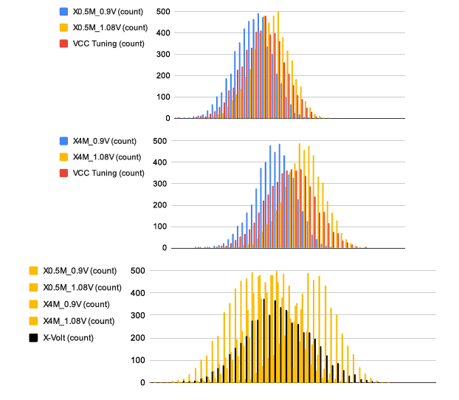
Introduction – Power Profile

Slide 8
Threat Model
Attackers are passive observers, which means that they have direct and indirect access to ASIC or FPGA without control
Attackers can monitor the power consumption and the cipher-text, but has not control of plain-text and power supply
The operations of tuning are randomized (randomly switching between different tuning scenarios)
Thus attackers cannot ascertain the specific driver strength and VCCs underlying for any particular point in time or operation

Slide 9
Methodology
Registers are most relevant for PSC attacks, since they build up considerable correlation between the processed data and the observable power consumption
The AES keys also store in the registers

Slide 10
ASICs - Runtime Tuning of Driven Strength
Static Driven-Strength
For the static driven-strength tuning during design time, they reconfigure the strength of each register of choice
They randomly select the highest available strength or the lowest available strength
To maintain the selected strength throughout the design flow, they make these register as don’t touch
Notes:
一開始會先建立簡單的的circuit scheme進行進行tuning

Slide 11
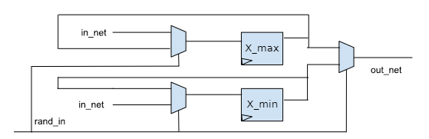
ASICs - Runtime Tuning of Driven Strength
Dynamic Driven-Strength
They design a tunable register (which is marked as don’t touch)
Notes:
1. The pair of registers, which is one with the high available strength, and the other with the low strength 2. The tunable register ouputs one of below signal: (a) the signal with stronger strength (b) the signal with weaker strength 3. The in_net signal will also feedback to the Mux, which prevents the toggle of the signal

Slide 12
ASICs - Runtime Tuning of VCCs
They assume that IVRs (integrated voltage regulator) or other tuning features are available
Dynamic VCC tuning is required only once per full AES round, because the CPA attack focuses on the last or first intermediate round of AES operation

Slide 13
FPGA - Runtime Tuning of Driven Strength
FPGA cannot reconfigure cell driven strength
So they reconfigure the driven strength and other parameter of the I/O pins

Slide 14
FPGA - Runtime Tuning of Driven Strength
Static Driven-Strength
They connects and hard-wires the register of choice to a I/O pin with highest/lowest driver strength

Slide 15
FPGA - Runtime Tuning of Driven Strength
Dynamic Driven-Strength
For the selected register, they connect the output of register of choice to two I/O pins, which is one with the high available strength, and the other with the low strength (same as above) (also use MUXes to select)

Slide 16
FPGA - Runtime Tuning of VCCs
They assume that some tuning feature is available, like FPGA on-board voltage regulation

Slide 17
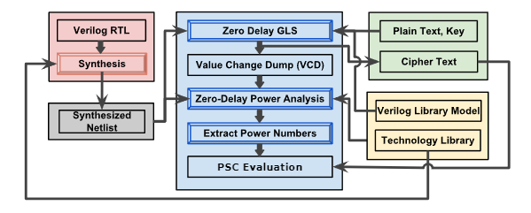
CAD Flow for Design-Time Evaluation of ASIC Power Profile
Notes:
接著會進行power analysis，以獲取actual power
Input : (1) RTL (AES crypto core) (2) standard cell library (tech file 、 verilog library model) (3) plain-texts and keys

Slide 18
CAD Flow for Design-Time Evaluation of ASIC Power Profile
The CAD flow serves to investigate the role that joint tuning of driven strengths and VCCs in the early design simulation time
The flow provides zero-delay power value(only the circuit-level computation as triggered by the plain-text and key inputs), and without any impact of layout effect or noises

Slide 19
CAD Flow for Design-Time Evaluation of ASIC Power Profile
Steps:
Synthesis RTL code
Also check its correctness
Perform zero-delay gate level simulation of the design
Dump VCD files after simulation
Do power simulation of the gate level simulation
To prevent compromising the result of PSC attack, only focus on the last(or first) round of AES

Slide 20
CAD Flow for Design-Time Evaluation of ASIC Power Profile
Scope of simulation :
They leverage noise-free zero-delay simulation
The glitches(noises) are less relevant to tuning driven strength and VCCs
Tuning has significant impact on not only power profiles overall but glitching activities
In the noise-free zero-delay simulation, it is easy to extract the information of peak-power value which is important for PSC attackers

Slide 21
CPA framework of security analysis
Use linear Pearson correlation coefficient (PCC)
Quantify the relationship between actual power and hypothetical power
Hypothetical power can be obtained by all possible keys values (can use the above power analysis flow to get the most promising candidate for all bytes, and then concatenates them to form the guess of correct key value)

Slide 22
CPA framework of security analysis
Steps:
Build up HD (Hamming Distance) power model

Slide 23
Conclusion
In the experiment, they found that:
Runtime tuning is more effective than static tuning in both ASIC and FPGA
In FPGA, the AES core is rendered(呈現) > 11.8x as resilient as the untuned baseline design
In FPGA, layout overhead is around +10% critical path dalay in the most resilient design, which is acceptable

